Slide 1
William Stallings
Computer Organization and Architecture
9th Edition
Chapter 3
Top Level View of Computer Function and Interconnection

Slide 2
Recall
Hardwired systems are inflexible
von Neumann architecture
  Data and instructions stored in single read-write memory
  Contents of memory addressable by location
    Without regard to type of data contained there
  Execution occurs sequentially (unless explicitly modified)
General purpose hardware can do different tasks – given correct control signals
Instead of re-wiring, supply a new set of control signals

Slide 3
What is a program?
A sequence of steps
For each step, an arithmetic or logical operation is done
For each operation, a different set of control signals is needed

Slide 4
Function of Control Unit
For each operation a unique code is provided
  e.g. ADD, MOVE
A hardware component accepts the code and issues the control signals
We have a general purpose computer!

Slide 5
Components
The Control Unit and the Arithmetic and Logic Unit constitute the Central Processing Unit
Data and instructions need to get into the system and results out
  Input/output
Temporary storage of code and results is needed
  Main memory

Slide 6
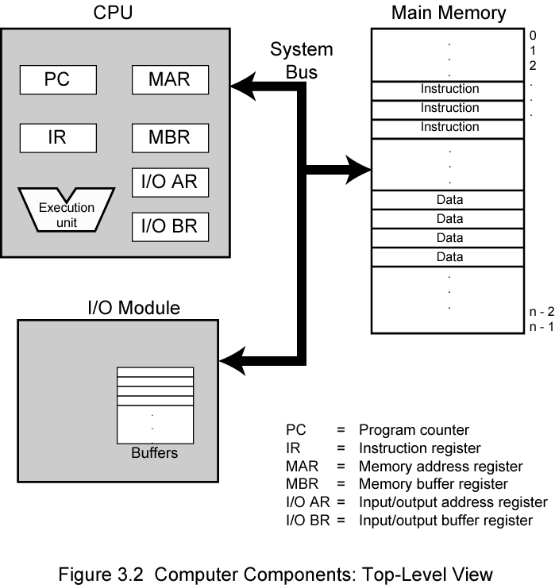
Computer Components:
Top Level View

Slide 7

Instruction Cycle
Two main steps:
  Fetch
  Execute

Slide 8
Fetch Cycle
Program Counter (PC) holds address of next instruction to fetch
Processor fetches instruction from memory location pointed to by PC
Increment PC to point to next instruction
  Unless told otherwise
Instruction loaded into Instruction Register (IR)

Slide 9
Execution Cycle
Control unit checks instruction register
Based on instruction found, sends appropriate control signals to accomplish the task

Slide 10
Instruction Categories
Processor-memory
  data transfer between CPU and main memory
Processor I/O
  Data transfer between CPU and I/O module
Data processing
  Some arithmetic or logical operation on data
Control
  Alteration of sequence of operations
  e.g. jump
Combination of above

Slide 11
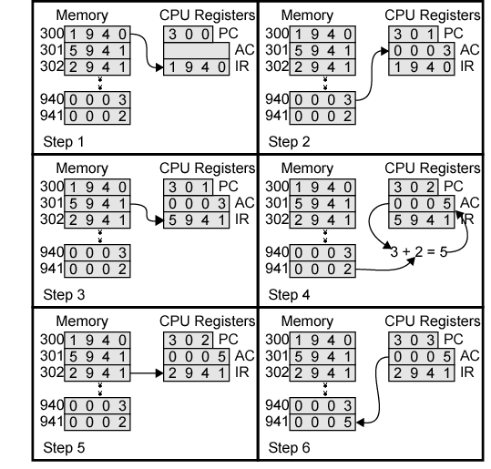
Example of Program Execution
Instruction format
16 bit words
Bits 0-3: opcode
Rest: address
Opcodes:
0001: load
0010: store
0101: add

Slide 12
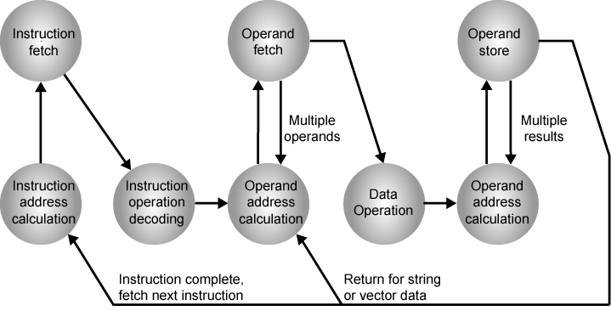
Instruction Cycle State Diagram

Slide 13
Interrupts
Mechanism by which other modules (e.g. I/O) may interrupt normal sequence of processing
Program
  e.g. overflow, division by zero
Timer
  Generated by internal processor timer
  Used in pre-emptive multi-tasking
I/O
  from I/O controller
Hardware failure
  e.g. memory parity error

Slide 14
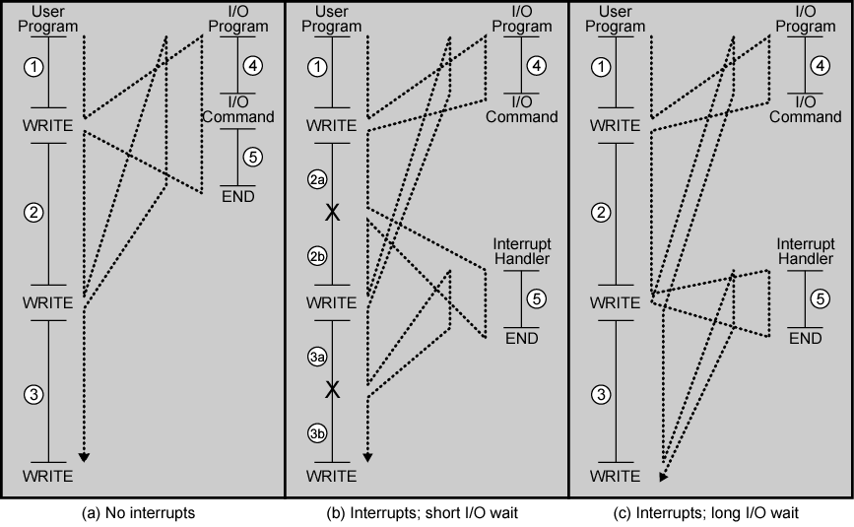
Program Flow Control

Slide 15
Interrupt Cycle
Added to instruction cycle
Processor checks for interrupt
  Indicated by an interrupt signal
If no interrupt, fetch next instruction
If interrupt pending:
  Suspend execution of current program
  Save context
  Set PC to start address of interrupt handler routine
  Process interrupt
  Restore context and continue interrupted program

Slide 16

Transfer of Control via Interrupts

Slide 17

Instruction Cycle with Interrupts

Slide 18
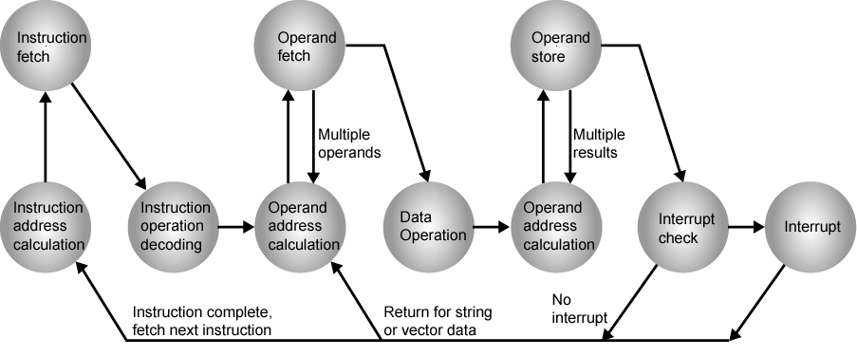
Instruction Cycle (with Interrupts) - State Diagram

Slide 19
Multiple Interrupts
Disable interrupts
  Processor will ignore further interrupts whilst processing one interrupt
  Interrupts remain pending and are checked after first interrupt has been processed
  Interrupts handled in sequence as they occur
Define priorities
  Low priority interrupts can be interrupted by higher priority interrupts
  When higher priority interrupt has been processed, processor returns to previous interrupt

Slide 20

Multiple Interrupts - Sequential

Slide 21
Multiple Interrupts – Nested

Slide 22
Interconnection Structures
All the units must be connected
Different type of connection for different type of unit
  Memory
  Input/Output
  CPU

Slide 23

Computer Modules

Slide 24
Memory Connection
Receives and sends data
Receives addresses (of locations)
Receives control signals
  Read
  Write
  Timing

Slide 25
Input/Output Connection(1)
Similar to memory from computer’s viewpoint
Output
  Receive data from computer
  Send data to peripheral
Input
  Receive data from peripheral
  Send data to computer

Slide 26
Input/Output Connection(2)
Receive control signals from computer
Send control signals to peripherals
  e.g. spin disk
Receive addresses from computer
  e.g. port number to identify peripheral
Send interrupt signals (control)

Slide 27
CPU Connection
Reads instruction and data
Writes out data (after processing)
Sends control signals to other units
Receives (& acts on) interrupts

Slide 28
Buses
There are a number of possible interconnection systems
Single and multiple BUS structures are most common
e.g. Control/Address/Data bus (PC)
e.g. Unibus (DEC-PDP)

Slide 29
What is a Bus?
A communication pathway connecting two or more devices
Usually shared transmission medium
Often grouped
  A number of channels in one bus
  e.g. 32 bit data bus is 32 separate single bit channels
Three functional groups
  Data
  Address
  Control
Power lines (may not be shown)

Slide 30
Data Bus
Carries data
  Remember that there is no difference between “data” and “instruction” at this level
Width is a key determinant of performance
  8, 16, 32, 64 bit

Slide 31
Address bus
Identify the source or destination of data
  e.g. CPU needs to read an instruction (data) from a given location in memory
Bus width determines maximum memory capacity of system
  e.g. 8080 has 16 bit address bus giving 64k address space

Slide 32
Control Bus
Control and timing information
  Memory read/write signal
  Interrupt request
  Clock signals

Slide 33

Bus Interconnection Scheme

Slide 34
Big and Yellow?
What do buses look like?
  Parallel lines on circuit boards
  Ribbon cables
  Strip connectors on mother boards
    e.g. PCI
  Sets of wires

Slide 35
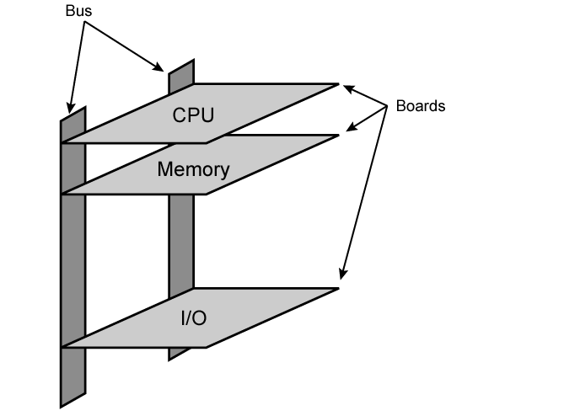
Physical Realization of Bus Architecture

Slide 36
Single Bus Problems
Lots of devices on one bus leads to:
  Propagation delays
    Long data paths mean that co-ordination of bus use can adversely affect performance
    If aggregate data transfer approaches bus capacity
Most systems use multiple buses to overcome these problems

Slide 37

Traditional (ISA)
(with cache)

Slide 38
High Performance Bus

Slide 39
Bus Types
Dedicated
  Separate data & address lines
Multiplexed
  Shared lines
  Address valid or data valid control line
  Advantage - fewer lines
  Disadvantages
    More complex circuitry
    Potential reduction in performance

Slide 40
Bus Arbitration
More than one module may need to control the bus
  e.g. CPU and DMA controller
Only one module may control bus at one time
Arbitration may be centralized or distributed

Slide 41
Centralized or Distributed Arbitration
Centralized
  Single hardware device controlling bus access
    Bus Controller
    Arbiter
  May be part of CPU or separate
Distributed
  Each module may claim the bus
  Control logic on all modules

Slide 42
Timing
Co-ordination of events on bus
Synchronous
  Events determined by clock signals
  Control Bus includes clock line
  A single 1-0 is a bus cycle
  All devices can read clock line
  Usually sync on leading edge
  Usually a single cycle for an event

Slide 43
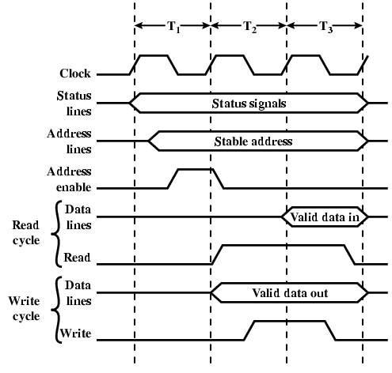
Synchronous Timing Diagram

Slide 44
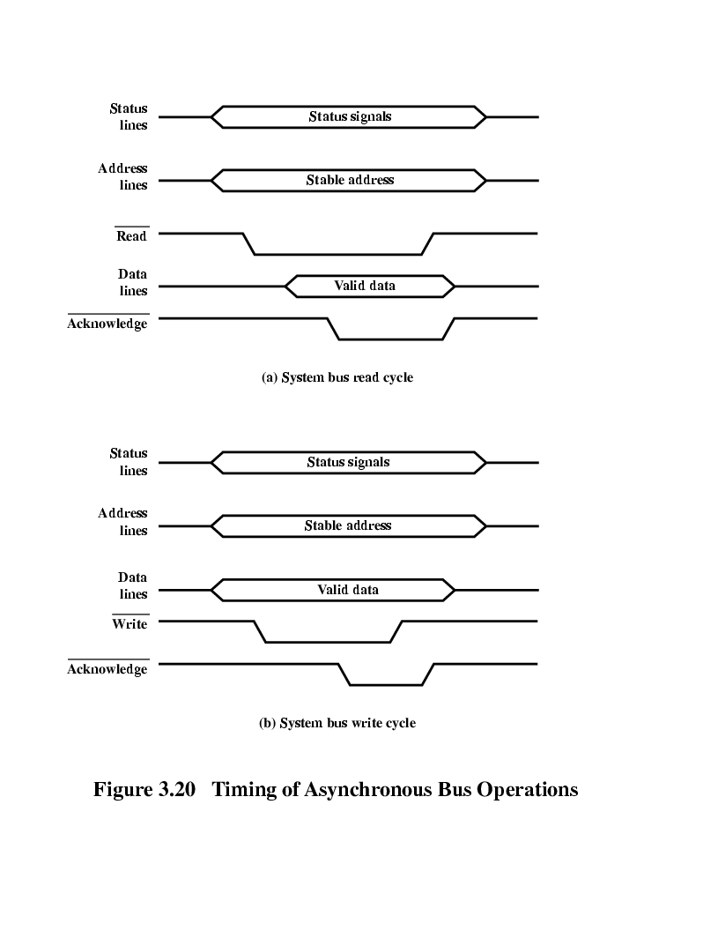
Asynchronous Timing – Read Diagram

Slide 45
Asynchronous Timing – Write Diagram

Slide 46
Point-to-point interconnect
Shared bus architecture standard for decades
Encountered electrical constraints when increasing the frequency of wide synchronous buses
Difficult to perform synchronization and arbitration in timely fashion
So, systems now use point-to-point interconnections

Slide 47
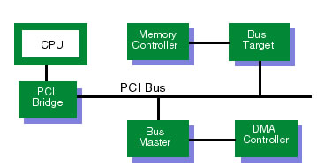
PCI Bus
Peripheral Component Interconnection
Intel developed for Pentium in 1992
Released to public domain
32 or 64 bit
49 mandatory signal lines
51 optional signal lines

Slide 48
PCI Bus Lines (required)
Systems lines
  Including clock and reset
Address & Data
  32 time mux lines for address/data
  Interrupt & validate lines
Interface Control
Arbitration
  Not shared
  Direct connection to PCI bus arbiter
Error lines

Slide 49
PCI Bus Lines (Optional)
Interrupt lines
  Not shared
Cache support
64-bit Bus Extension
  Additional 32 lines
  Time multiplexed
  2 lines to enable devices to agree to use 64-bit transfer
JTAG/Boundary Scan
  For testing procedures

Slide 50
PCI Commands
Transaction between initiator (master) and target
Master claims bus and determines type of transaction
  e.g. I/O read/write
Address phase
One or more data phases

Slide 51
PCI Express
PCI scheme not able to keep pace with data rate demands of current devices
PCI Express (PCIe) developed in 2004
  Point-to-point interconnect scheme
  Key requirement is high capacity to support needs of higher data rate I/O devices
    E.g., Gigabit Ethernet
  Another requirement – need to support time dependent data streams
    E.g., video-on-demand
  Also, cannot treat all data as equal
    Streaming data should be processed first
    Need to tag data so it can be prioritized

Slide 52
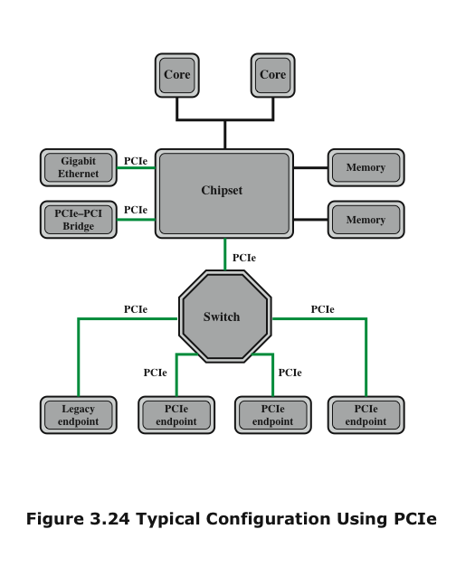
PCIe Configuration

Slide 53
Quick Path Interconnect (QPI)
Introduced in 2008
Multiple direct connections
  Direct pairwise connections to other components eliminating the need for arbitration found in shared transmission systems
Layered protocol architecture
  These processor level interconnects use a layered protocol architecture rather than the simple use of control signals found in shared bus arrangements
Packetized data transfer
  Data are sent as a sequence of packets each of which includes control headers and error control codes

Slide 54
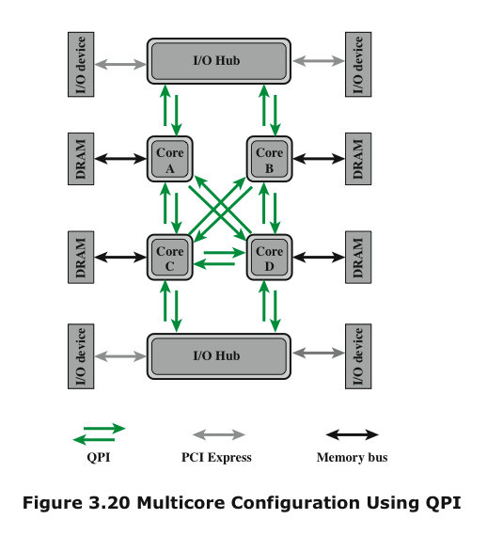
Multicore Configuration using QPI

